Slide 1





















always and
forever
Lara Jean
Introducing the presenters
Gender
And
Society
PS. Listen
Carefully
Let’s Start!

Slide 2










Presenter 4
Presenter 1
Presenter 5
Presenter 2
Presenter 4
Presenter 3

Slide 3
always and
forever
Lara Jean
Introducing the presenters
Gender
And
Society
P.S .
Listen
Carefully
Let’s Start!

Slide 4

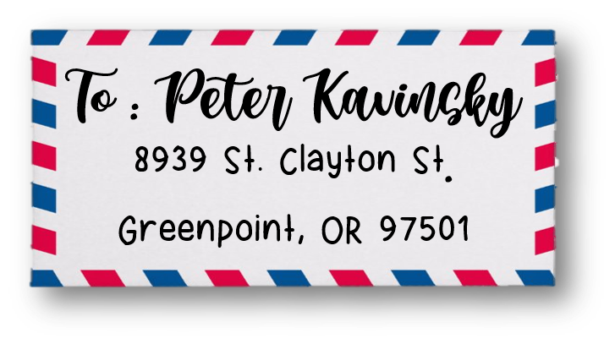






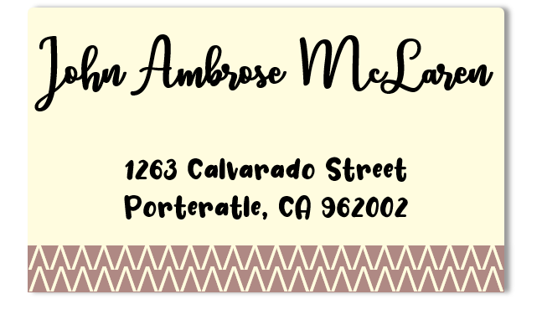



Lucas James
2398 Laydon Ave.
North Falls, OR
97305
To : Kenny Glickson
(Boy’s Cabin 11 4)
7356 Elihart St.
North Falls, OR
97305
Josh Sanderson
9133 Jefferson St.
Greenpoint, OR 97708
S

Slide 5







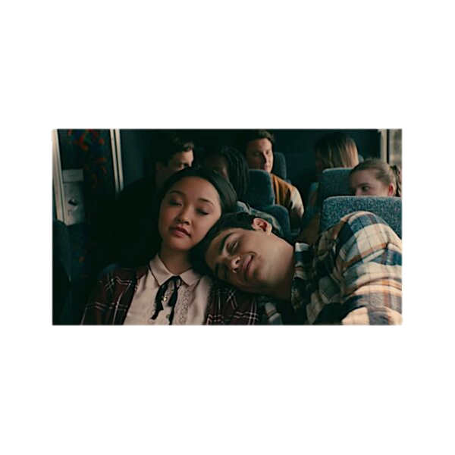


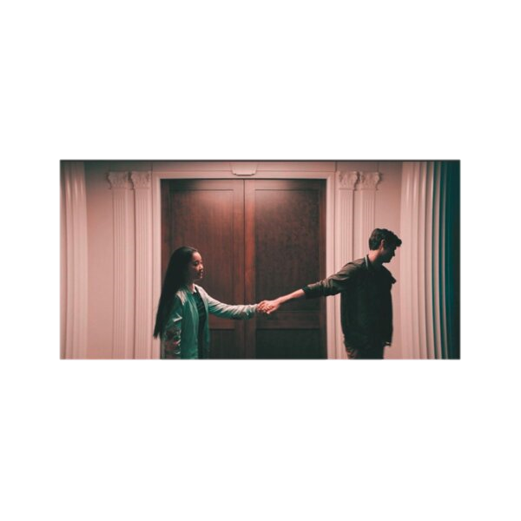


To : Peter Kavinsky
8939 St. Clayton St.
Greenpoint, OR 97501
Contract Sept. 15
1) NO kISSING
(hand in back pocket Is OK)
2) Fight Club / Sixteen candles
Double Feature
3) NO SNITCHING
4) Peter will write Lara Jean a note everyday
5) Lara Jean must go to parties with Peter lacrosse games
6) Peter drives me + Kitty to school
SKI TRIP !

Slide 6




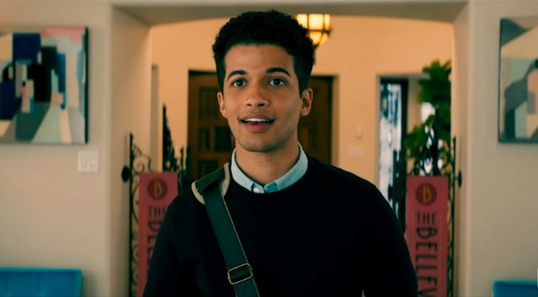

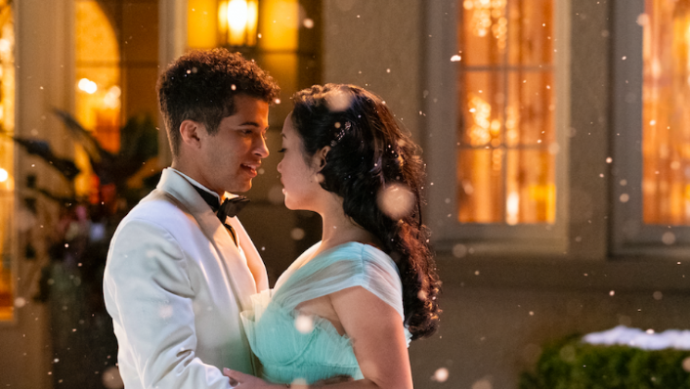
John Ambrose McLaren
1263 Calvarado Street
Porteratle, CA 962002
Dear John Ambrose McClaren,
I know the exact day it all started. Fall, eight grade. We got caught in the rain when we had to put all the softball bats away after gym. We started torun back to the building, and I couldn’t run as fast as you, so you stopped and grab my bag too. It waseven better than if you’d grabbed my hand. I still remember the way you looked – yout T-shirt was struck to your back, your hair wet like you just came out of the shower. When it started to pour, you whooped and hollered like a little kid. There was the moment --- you looked back at me. And your grin was as wide as your face. You said, “Come on, LJ!"
VVVVVVVVVVVVVVVVVVVVVV
VVVVVVVVVVVVVVVVVVVVVV

Slide 7

Thank
You !

Slide 8
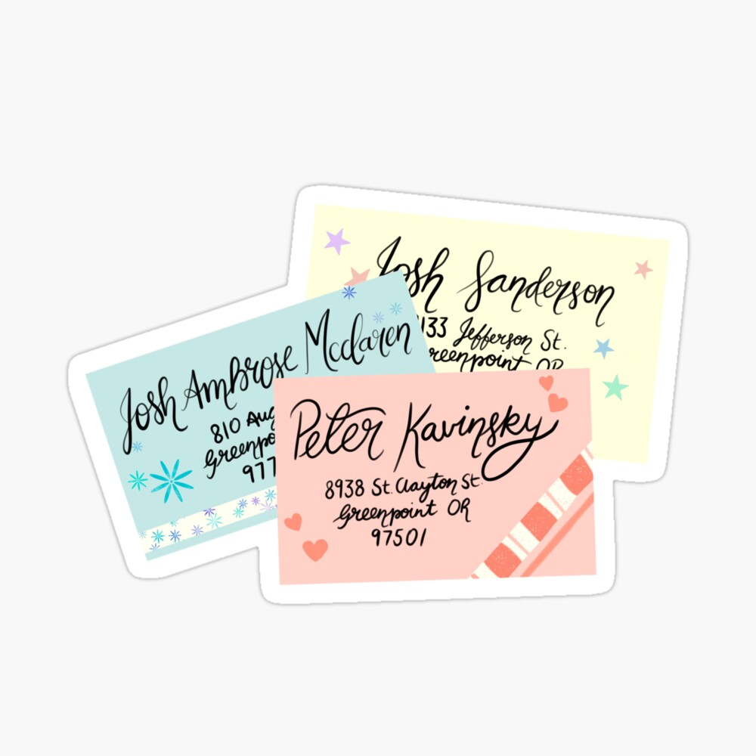


To All The Boys I’ve Loved Before
Power
Point
Free template &fonts

